Slide 1

SMART ENTRY TAIL GATING ACCESS SYSTEM
AKULA ASHRITH SAI
COURSE: EMBEDDED SYSTEMS
SUPERVISOR:MEHAK MAJEED
SURE ProEd
PUTTAPARTHI, ANDHRA PRADESH

Slide 2
CONTENTS:
INTRODUCTION
COMPONENTS
METHODOLOGY
HARDWARE SETUP
SAMPLE IMAGES
WORKING
APPLICATIONS
FUTURE SCOPE

Slide 3
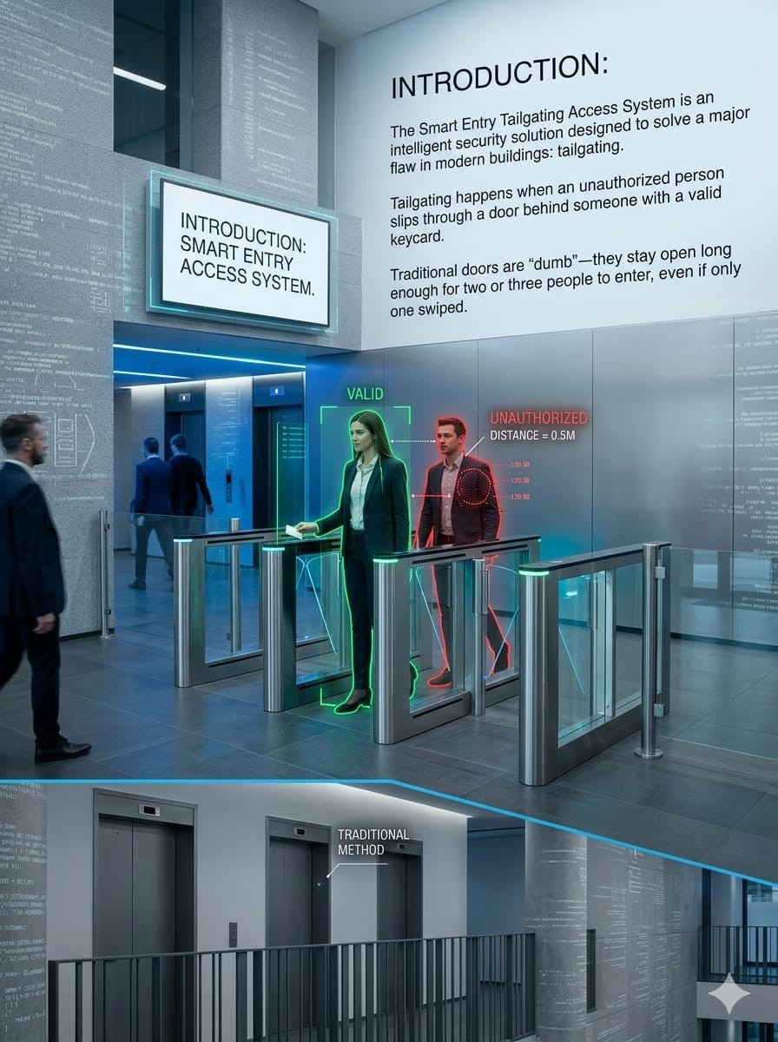
INTRODUCTION:
The Smart Entry Tailgating Access System is an intelligent security solution designed to solve a major flaw in modern buildings: tailgating.
Tailgating happens when an unauthorized person slips through a door behind someone with a valid keycard.
Traditional doors are "dumb"—they stay open long enough for two or three people to enter, even if only one swiped.

Slide 4
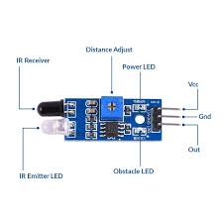
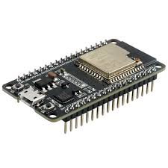
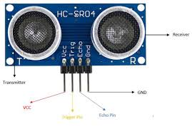
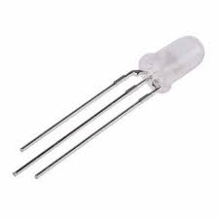
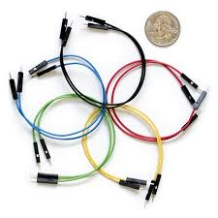

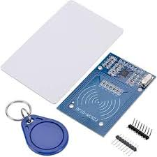
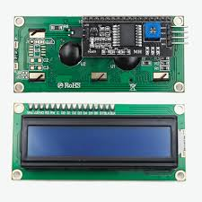
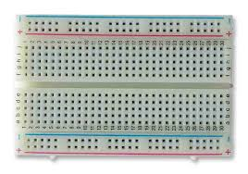
COMPONENTS USED:
ULTRASONIC SENSOR(HCSR04)
IR SENSOR
ESP-32
RC522 RFID READER
RFID TAGS
16*2 I2C LCD DISPLAY
BREADBOARD
RGB LED
RESISTORS(220 OHMS)
JUMPER WIRES

Slide 5
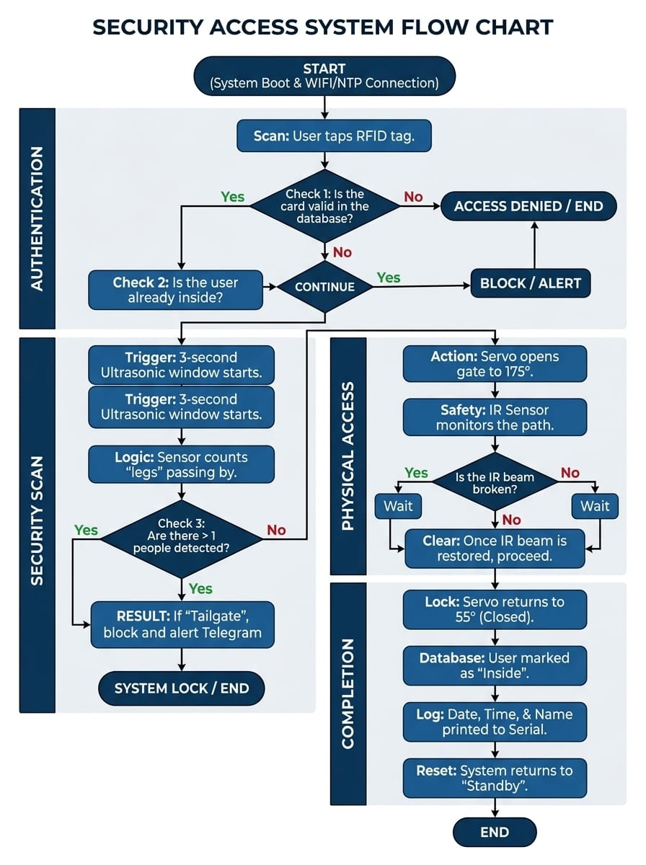
METHODOLOGY:

Slide 6
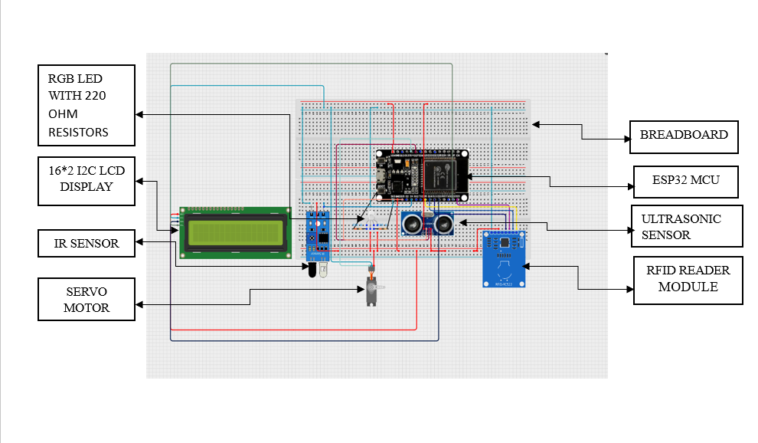
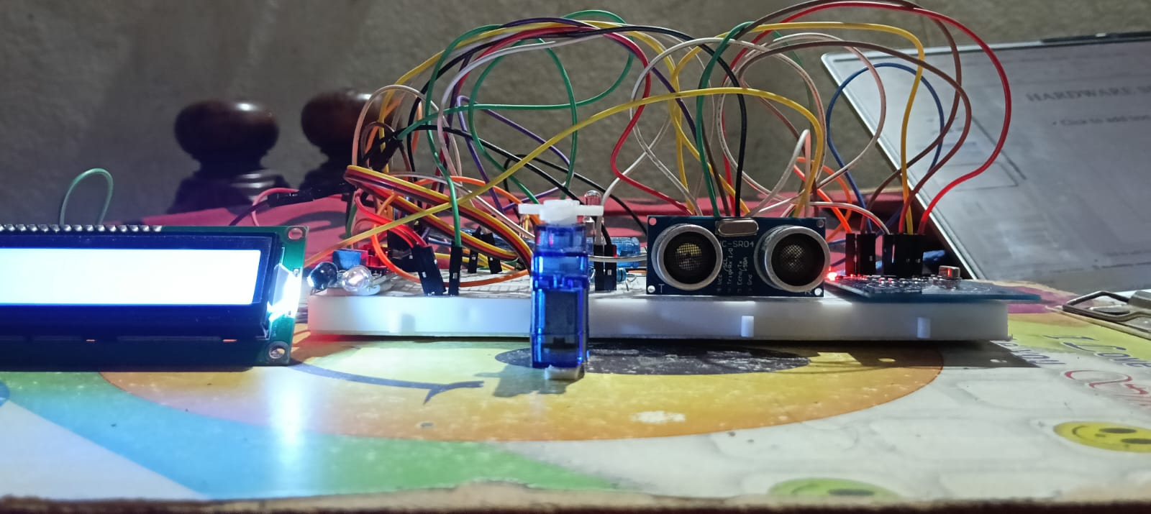
HARDWARE SETUP:

Slide 7
WORKING:
The working of this Secure Gate Access System can be broken down into four distinct phases: Authentication, Security Screening, Physical Access, and Logging. The project uses a "Multi-Factor" approach by combining identity (RFID) with physical behavior (Ultrasonic leg counting).
1. Authentication Phase (The "Who")
The process begins when a user taps an RFID Tag against the MFRC522 reader.
UID Verification: The ESP32 reads the unique ID of the tag and compares it against a predefined list (users[]) in the code.
Anti-Pass back Check: The system checks the is Inside variable. If the user is already marked as "Inside," the system denies entry and sends a Telegram Alert, preventing one person from "passing back" their card to a friend.

Slide 8
Security Screening Phase (The "Tailgate Check")
Once the card is valid, the system doesn't just open the gate; it starts a 3-second Security Scan using the HC-SR04 Ultrasonic Sensor.
Ultrasonic "Ping": The sensor sends out sound waves. If they bounce off an object within 18cm, it registers a "Leg."
Counting Logic: The code is designed to look for a pattern:
Object detected (No object) Object detected.
Tailgate Detection: If the sensor counts 1 person, the gate proceeds to open.
If it counts 2 or more people (multiple legs passing with a gap), it triggers a Tailgate Alert, keeps the gate locked, and notifies the administrator via the Telegram Bot.

Slide 9
Physical Access Phase (The "Gate")
If the scan passes (1 person detected), the Servo Motor acts as the physical barrier.
Opening: The servo rotates to 175° to move the gate arm.
IR Sensor Monitoring: The gate does not close on a timer. Instead, it uses an IR Sensor (Infrared) placed at the entrance.
Auto-Close: The IR sensor emits a beam. When the person walks through, they break the beam (LOW). Once they clear the beam (HIGH), the ESP32 knows the person is safely through and moves the servo back to 55° to lock the gate.

Slide 10
Logging and Connectivity (The "Record")
Throughout the entire process, the ESP32 acts as a data logger.
NTP Time Sync: During startup, the ESP32 connects to Wi-Fi and fetches the global date and time from Google’s NTP servers.
Serial Table: Every event (Success, Tailgate, Re-entry attempt) is printed to the Serial Monitor in a formatted table, showing the Date, Time (seconds since boot), Username, and Status.
IoT Alerts: Using the Universal Telegram Bot library, the system sends real-time security notifications to your phone, allowing you to monitor the gate from anywhere in the world.

Slide 11
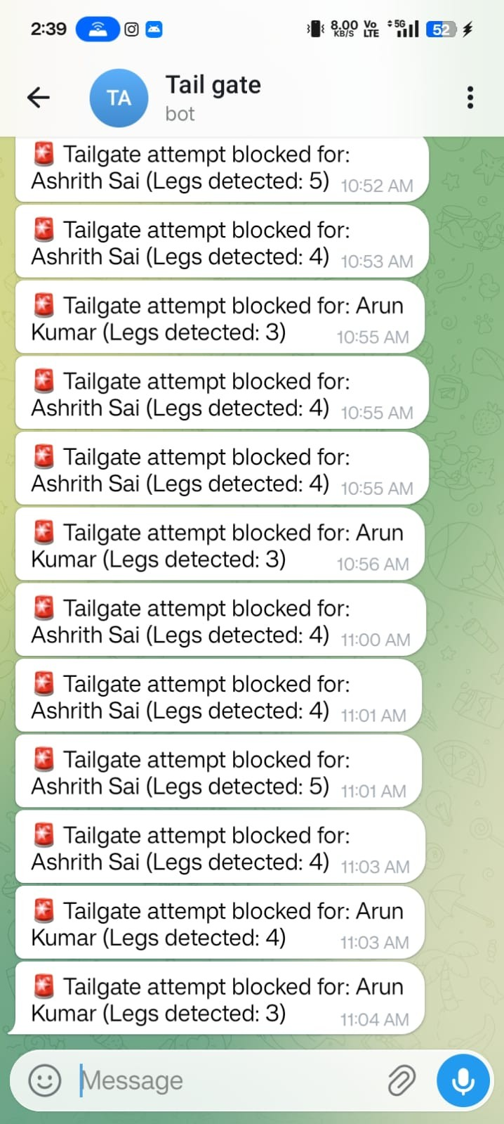
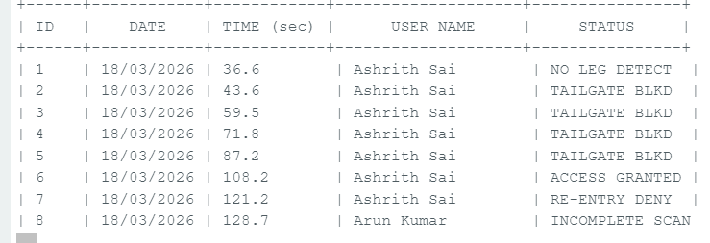
SAMPLE IMAGES:

Slide 12
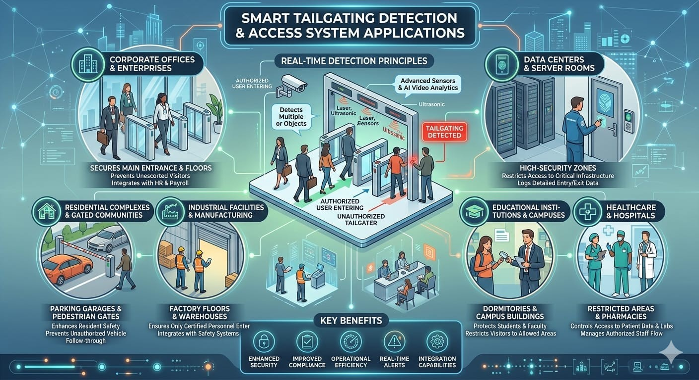
APPLICATIONS:

Slide 13

FUTURE SCOPE:

Slide 14


